Slide 1
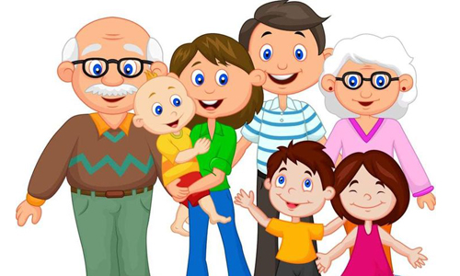
Unit 11-Lesson 2.Page 8,9.

Slide 2
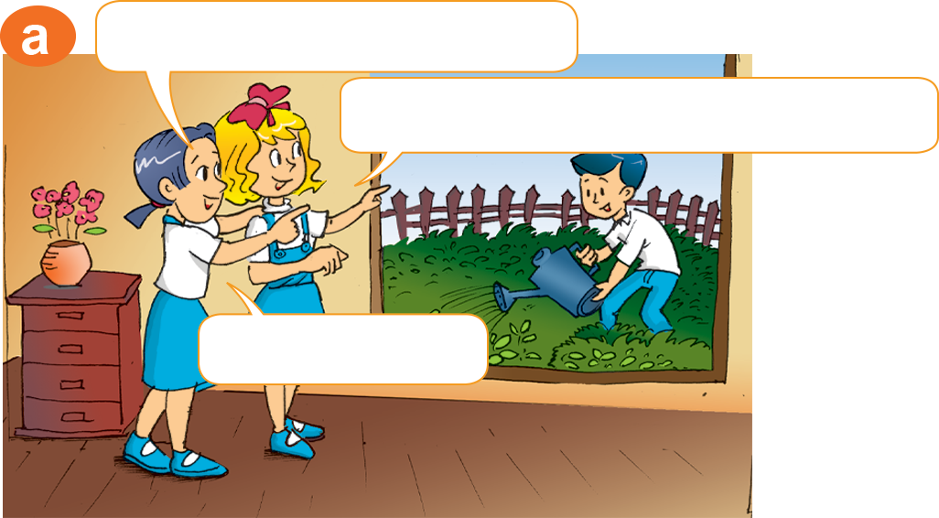
That’s my brother.
How old is your brother?
He’s seven.

Slide 3
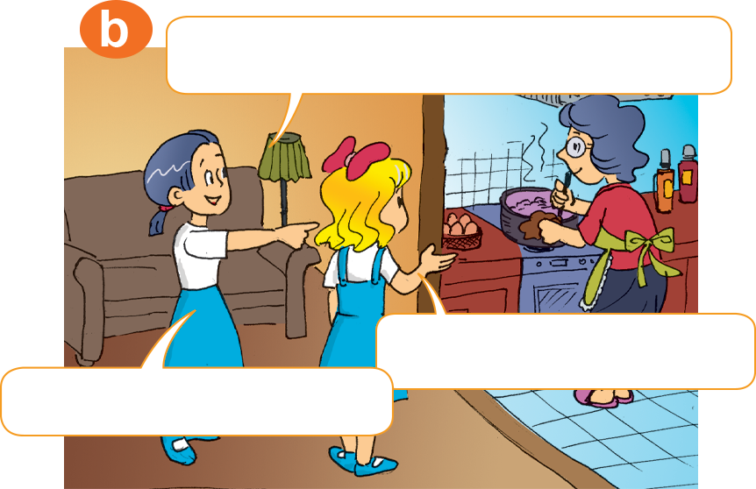
That’s my grandmother.
How old is she?
She’s sixty-five.

Slide 4
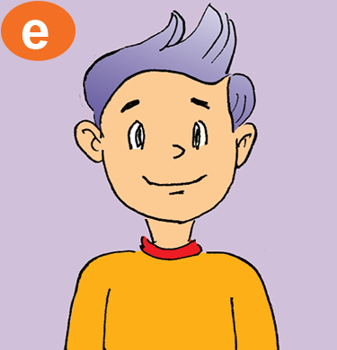
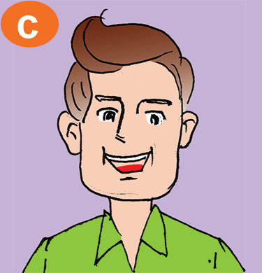
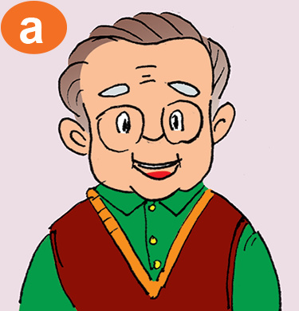
How old is your ______?
He’s ____.
68
42
13

Slide 5
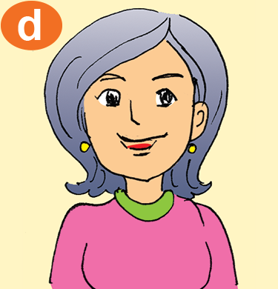
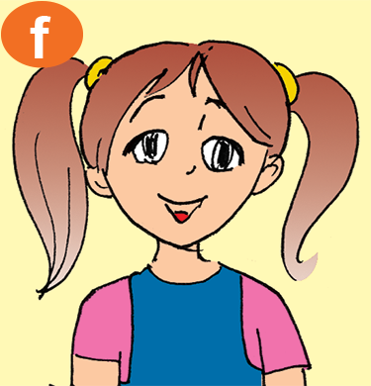
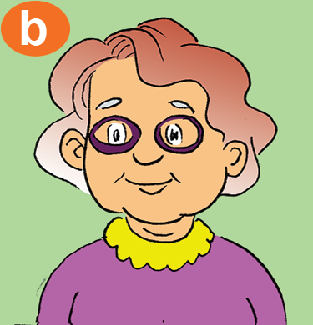
How old is your _____?
She’s ___.
65
41
10

Slide 6
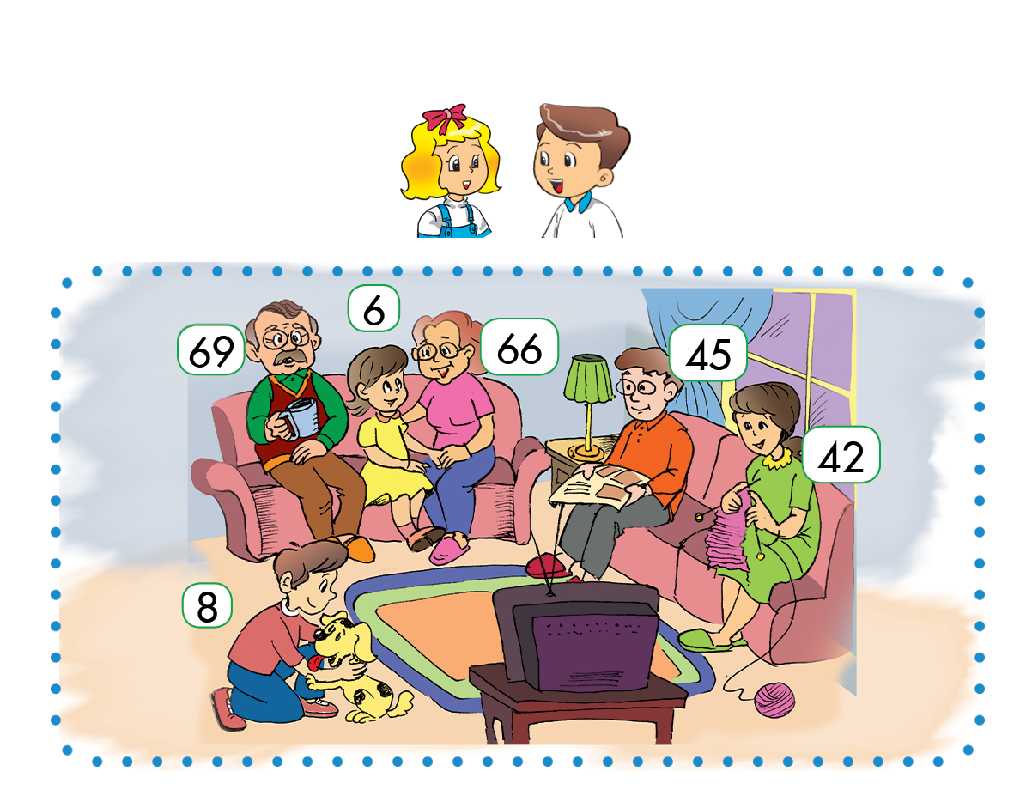
How old is your ____?
_____.
6
66
45
69
42
8

Slide 7
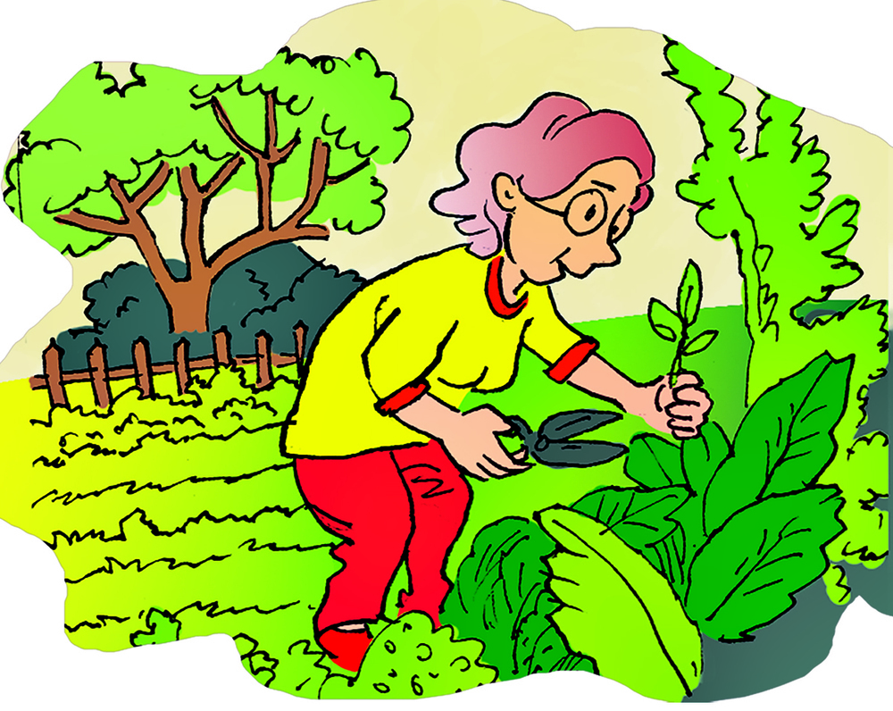
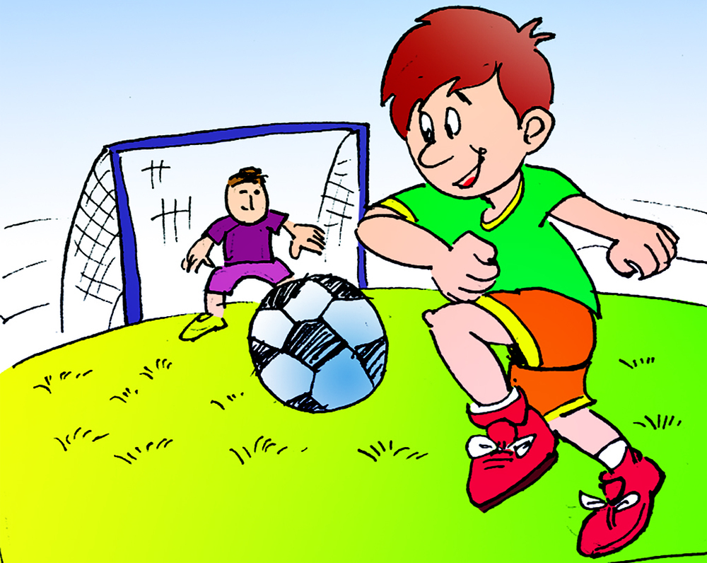
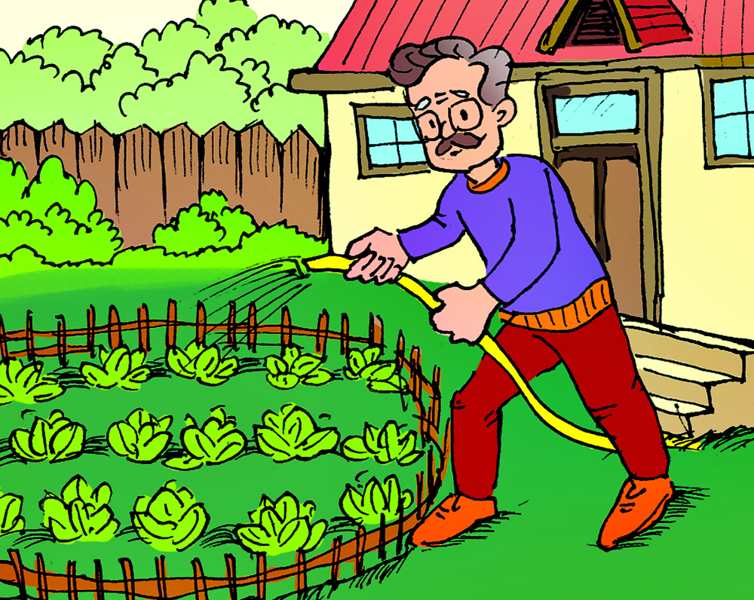
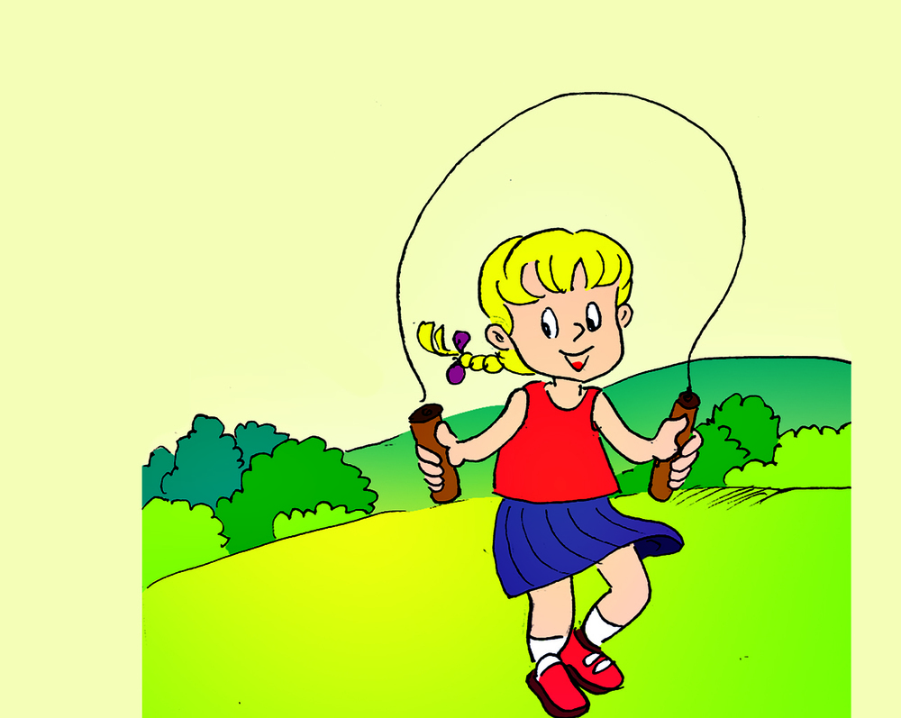
4
b
3
b
2
b
1
b

Slide 8
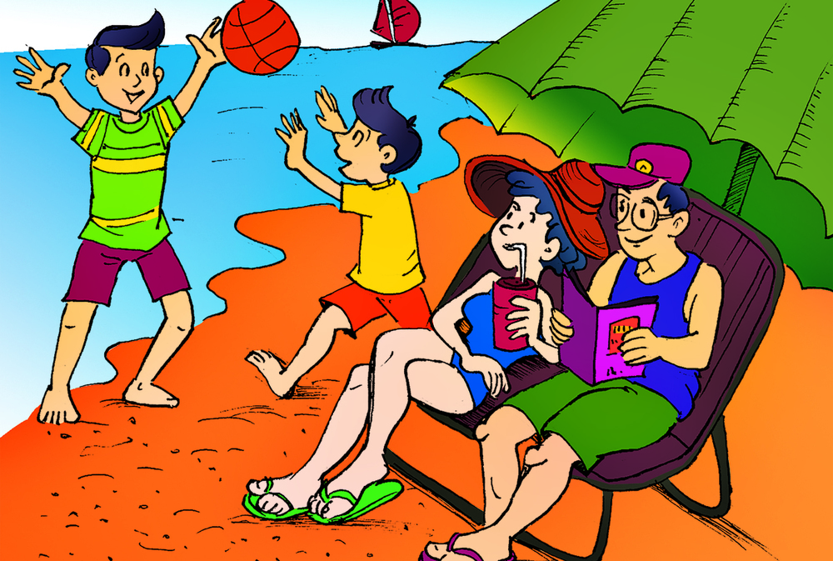
 | Age
Quan | 10
His father
His mother
His brother
Hi! My name is Quan. I am ten years old. That is a picture of my family.
My father is forty-four years old. My mother is thirty-nine years old. My brother is fourteen years old.
44
35
14

Slide 9
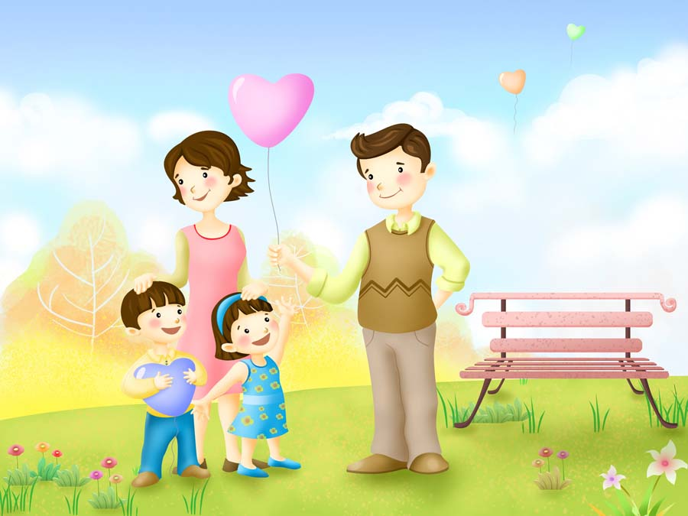
1.How old are you?
I am ...
2.How old is your mother?
She is ...
3.How old is your father?
He is ...
4.How old is your brother/sister?
9 years old.
__ years old.
__ years old.
He/She__.

